Slide 1
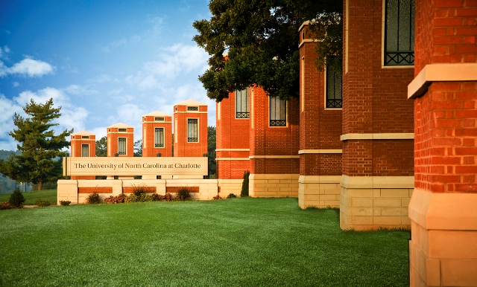
Smart data summarization & contextualization
Sarath Kumar Ravindran
Ritika Patil
Akash Bulbule
Adarsh Manjunath

Slide 2
Problem
Big Data sources are unprocessed and unsearchable.
Relevant information needs to filtered out
Data variety worsens and complicates data extraction
Need of method for synthesizing Big data from sources.

Slide 3
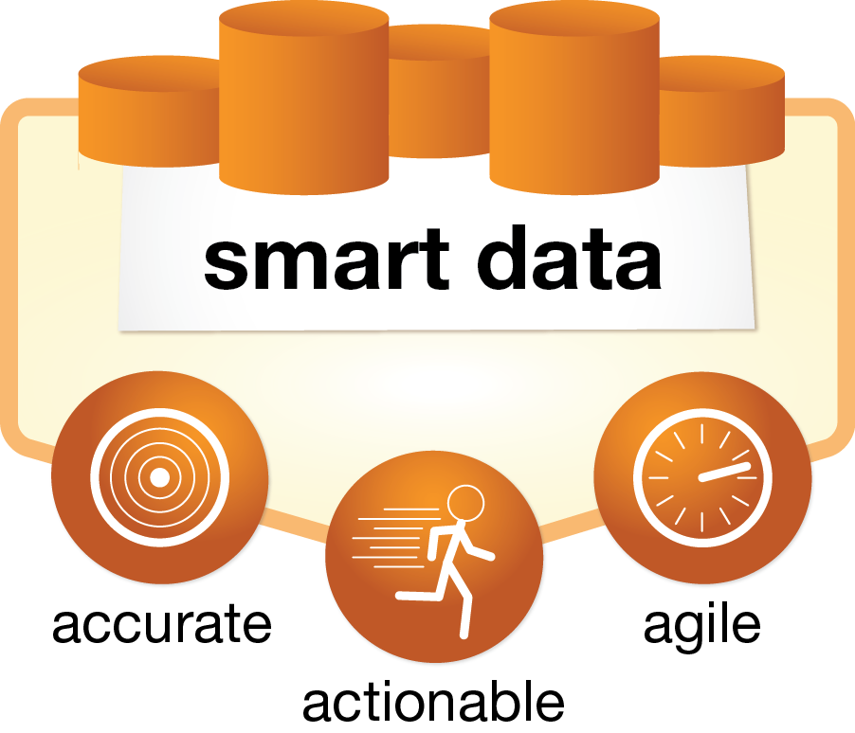
Solution

Slide 4
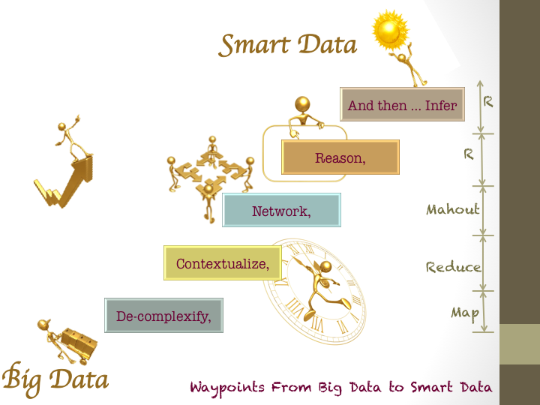
Problem
Notes:
Barb

Slide 5
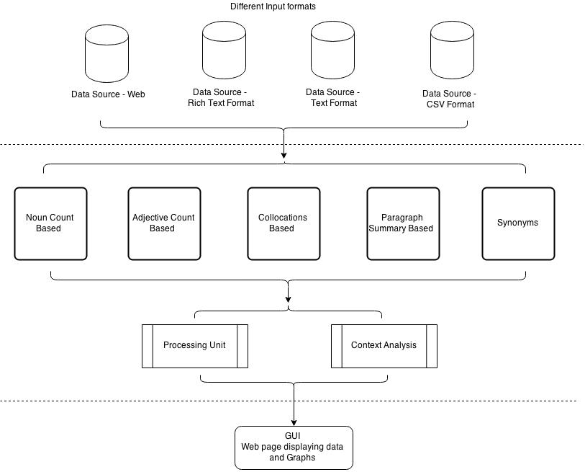
Architecture
Notes:
Barb

Slide 6
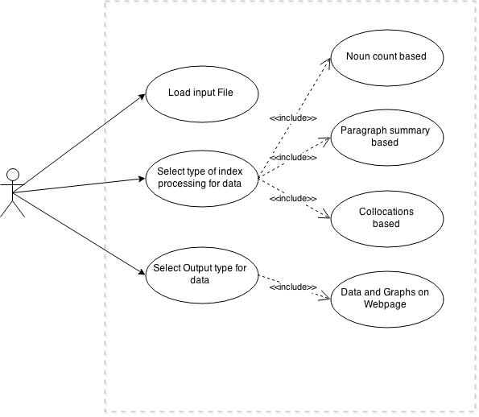

Slide 7
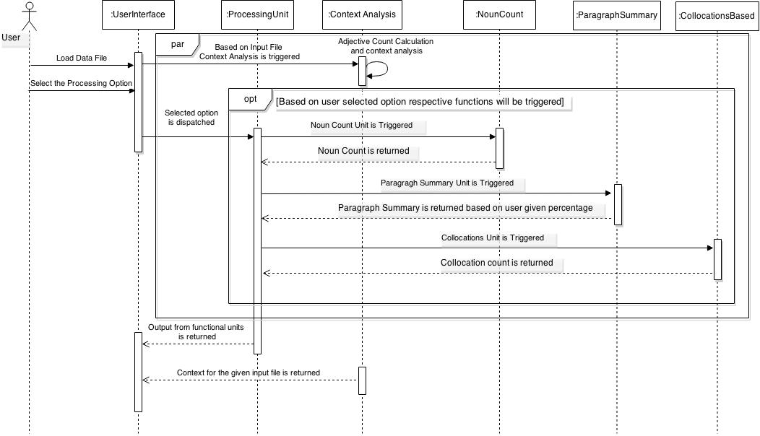
Sequence Diagram
Notes:
Barb

Slide 8
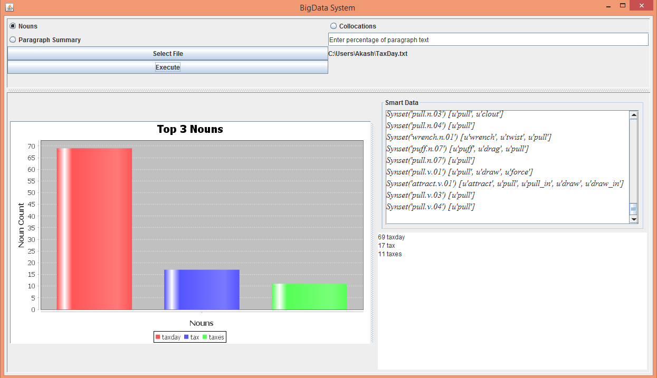
Noun Count

Slide 9
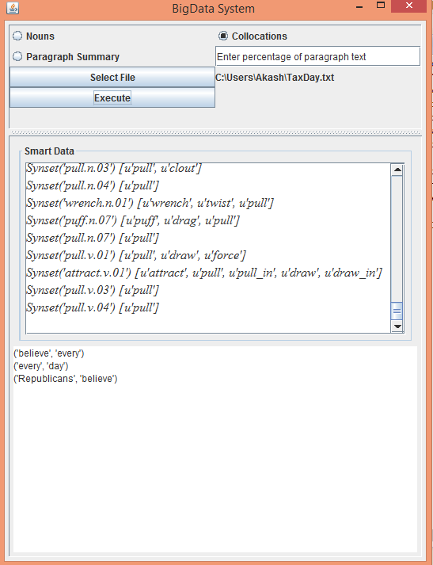
Top Collocations

Slide 10
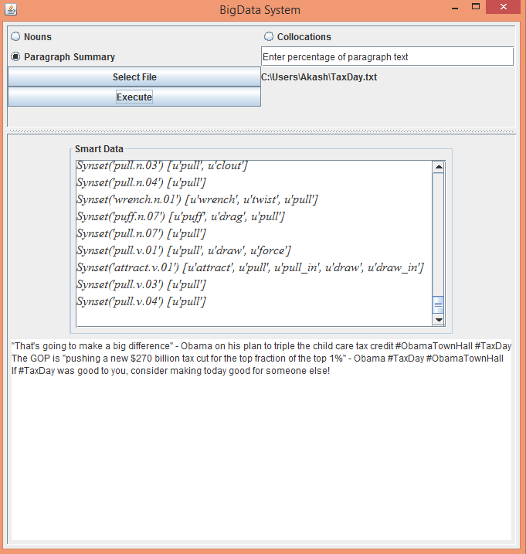
Paragraph Summary

Slide 11
DEMO

Slide 12
Conclusion
Designed and implemented approach for data summarization and contextualization
Method will convert a data source to smart data
Smart Data can be searchable by search crawler
Applicable on wide range of big data sources

Slide 13
Thank You!
Notes:
Barb

